Slide 1
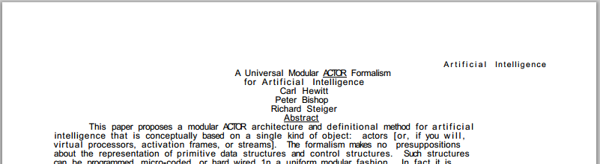
What is the actor model?
Formally: mathematical model of computation which embraces indeterminacy
Informally: threads passing messages
Notes:
Not really so simple; all of the benefits of actors require adherence to certain constraints; not necessarily threads either…

Slide 2
Actor Model
Obscure yet pervasive
Underlies most modern concurrency innovation
More powerful than Turing machine (What!)
Scales down to simplest OSless microprocessors
Scales up to the largest networks and MMOGs
Easy to simulate, isolate, test, and prove
Well supported by academic community
Notes:
Many systems, frameworks, and languages use degrees of the actor model without calling it such
Don’t have time to defend these claims, follow links at the end of the slide

Slide 3
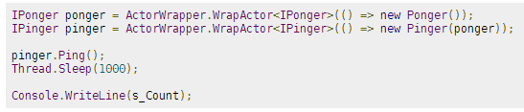
N-act – .NET actor framework
Implements messages as method calls
Generates proxy given an interface
Supports:
Events
Void and Task<T> return types
Set-only or Task<T> read-only properties

Slide 4
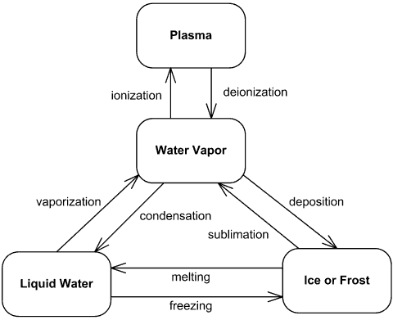
State Machine
All systems track states, but most state machines aren’t formally defined
SM frameworks provide reuse and prevent errors
Primitives:
States
Triggers
Logic tied to trigger events

Slide 5
Hierarchical State Machine
Superimposed states - provides a reuse mechanism
This:
Becomes:

Slide 6
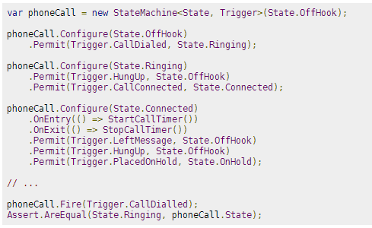
Stateless - .NET state machine framework
Uses generics to provide strongly typed states and triggers

Slide 7
SureMed Packaging System driver framework

Slide 8
Example: Barcode scanner

Slide 9
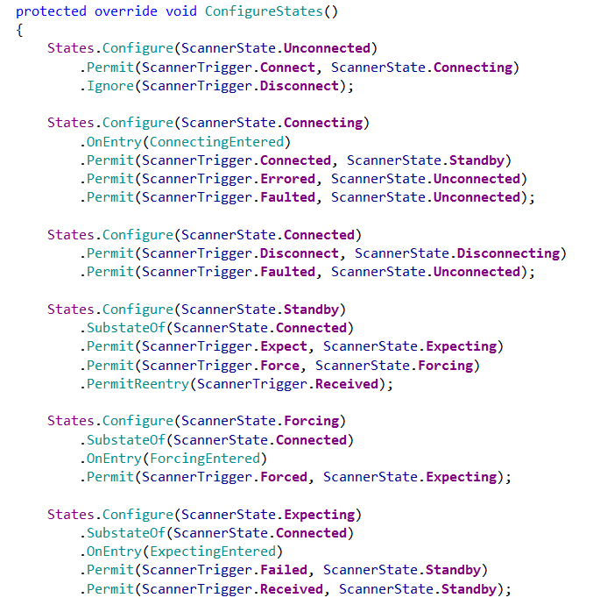
Configuration
Notes:
Fluent configuration by specifying the enumeration member
Valid transitions are designated via the triggers enumeration
The hierarchy is established by specifying a parent
Events are attached to the entry or exit of states

Slide 10
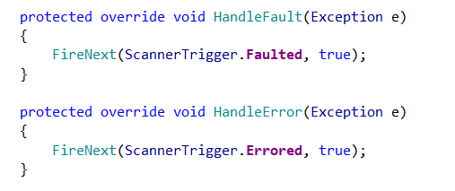
ActorBase duties
An actor must handle its own errors

Slide 11
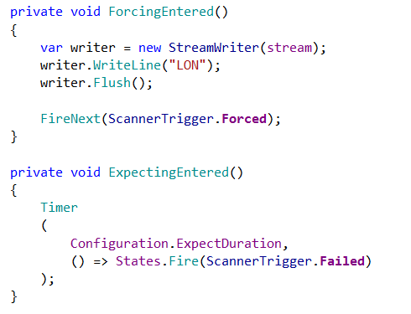
Handling state transition events
Don’t have to check for valid start state
Don’t worry about concurrency, single threaded within actor
Timer callback happens in actor’s context
Is automatically aborted if state changes

Slide 12
Complex example
Notes:
State diagram for the storage robot

Slide 13
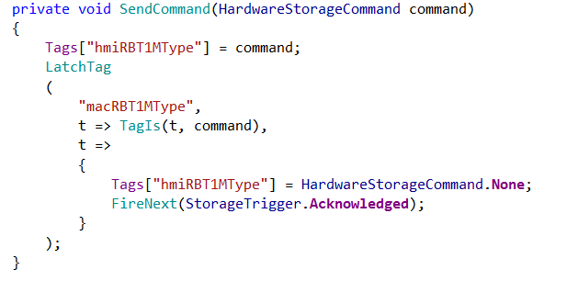
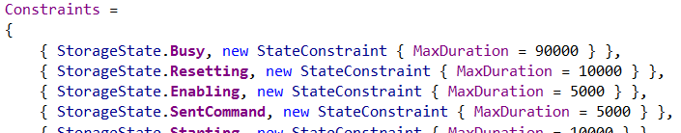
PLC communication
Watches for a tag change handling races; aborts if current state changes
Firing condition; TagIs() handles tag type conversion
Ensures that the state transitions within expected time
Notes:
Latch and watch helpers replace hundreds of lines of code

Slide 14
Driver composition
Notes:
Directors manage other actors; actors

Slide 15
Further reading/viewing
Actor Model
Carl Hewitt on Channel 9
Alex Miller’s Actor Concurrency links page

